Slide 1
CMX Systems
FREE USB Firmware for ColdFire MCF5222x
and Other Products

Slide 2
Introduction
CMX provides a suite of free USB Firmware for MCF5222x which includes:
  USB Device
  USB Host
  OTG
CMX also provides a variety of full featured products designed to decrease your time to market

Slide 3
USB Device
Components
USB Device Drivers and HID, CDC Class Drivers are included with
Add On Components available for purchase:
Mass Storage + FAT file system
Bootloader
USB Embedded Pipe
USB Reliable File Interface
CMX-RTX and CMX-TINY+ RTOSes
CMX-MicroNet and CMX TCP/IP Stacks

Slide 4
CMX-USB Bootloader
Simple reliable Bootloader sits in first 8K of flash never to be overwritten
Download program can connect to it though USB Embedded Pipe using any windows application environment you choose.
Does not use the DFU class (Device Firmware Upgrade) which requires a special windows driver

Slide 5
CMX-USB-Mass Storage
Mass Storage driver makes the MCF5222x appear as a standard flash drive.
Target media would typically be an SD card connected by SPI.
CMX THIN file system can be used to access the media while windows is not connected.

Slide 6
CMX-USB-Embedded Pipe
Windows driver which creates one or more COM objects on a PC
  Simple pipe through USB to target end point
  provides multiple USB device access simultaneously
  supports any programming language ( I.e.VC++, VBScript)
  works with composite devices
  Full use of USB bandwidth
Easy way to connect embedded application to your host

Slide 7
CMX-USB-RFI
Reliable File Interface
Mass Storage is great for flash drives but causes problems for other applications;
  Synchronization
  Forced to use FAT file system
  Unreliable file system
  Security
  Windows has control of the target

Slide 8
CMX-USB-RFI
Reliable File Interface
Windows XP USB RFI driver from CMX uses USB Embedded Pipe Driver to communicate between target file system and windows.
Architecturally more like NFS type solution
Look and feel is identical to standard flash drive
All Mass Storage issues resolved

Slide 9
CMX-USB Mass Storage
Full compatibility with CMX Flash File Systems
Supports: MMC/SD, HDD, NAND, DataFlash, Compact Flash
Can be integrated with CMX Flash File Systems and provided as a complete project

Slide 10
USB Host
Components
USB Host Driver, MST, HID Class Drivers and a limited function FAT file system is provided with MCF5222x
Add On Components available for purchase:
Full Mass Storage + FAT file system
Mass Storage Bootloader
Other Class Drivers (Printer, CDC)
CMX-RTX and CMX-TINY+ RTOSes
CMX-MicroNet and CMX TCP/IP Stacks

Slide 11
USB Host Bootloader
Minimum build of the USB host, with mass storage and FAT file system which allows a device to be reliably field upgraded from a flash memory stick.
Simple reliable Bootloader sits in first 16K of flash never to be overwritten

Slide 12
Class Drivers
Additional host class drivers available and under development
PrinterLite
CDC Serial

Slide 13
Full FAT File Systems
Limited, object only version provided with MCF5222x
THIN system provides full feature set and is optimized for small systems
FAT system provides full feature set but also includes many performance enhancing options including various caching mechanisms.

Slide 14
CMX Flash File Systems
CMX-FFS: Base Failsafe FFS with RAM Drive
CMX-FFS-FAT: FAT12/16/32 File System
CMX-FFS-THIN: FAT12/16/32 File System for Microprocessors with limited RAM/ ROM
CMX-FFS-TINY: Limited Resource Failsafe System ( small sector, ST Serial flash)

Slide 15
CMX-FFS
Base Flash File System
  100% Failsafe
  Multiple volumes
  Wear-leveling
  Directories
  Boot sector support
  Standard drivers for RAM

Slide 16
CMX-FFS
Flash File System Options
CMX-FFS-NOR: NOR Flash Driver
CMX-FFS-NAND: NAND Flash Driver
CMX-FFS-DF: Atmel DataFlash Drivers

Slide 17
CMX-FFS-FAT
FAT12/16/32 Compliant File System
Long File Names
Multiple Volumes
Drivers:
  Compact Flash (True IDE and Memory I/O)
  MMC/SD (SPI S/W or H/W)
  RAM
Simple Flash, Flash Translation and DataFlash options

Slide 18
CMX-FFS-FAT
FAT File System Options
CMX-FFS-FAT-DF: Reliable Driver for Atmel DataFlash
CMX-FFS-FAT-DFM: Simple Flash Translation Layer for Multiple Atmel DataFlash devices
CMX-FFS-FAT-SFTL: Simple Flash Translation Layer for NAND devices
CMX-FFS-FAT-FTL: Flash Translation Layer for NAND devices

Slide 19
CMX-FFS-THIN
Reduced Footprint File System
FAT 12/16/32
Long File Names
Multiple Volumes
Drivers:
  Compact Flash (True IDE and Memory I/O)
  MMC/SD (SPI S/W or H/W)
  RAM
Simple Flash, Flash Translation and DataFlash options
Designed for Microprocessors with limited ROM/RAM

Slide 20
CMX-FFS-THIN
File System Options
CMX-FFS-THIN-DF: Reliable Driver for Atmel DataFlash
CMX-FFS-THIN-DFM: Reliable Driver for Multiple Atmel DataFlash devices
CMX-FFS-THIN-SFTL: Simple Flash Translation Layer for NAND devices
CMX-FFS-THIN-FTL: Flash Translation Layer for NAND devices

Slide 21
CMX-FFS-TINY
Failsafe Flash File System for Microcontrollers with minimal resources
  Use with small sector flash
Available in four configurations

Slide 22
CMX-FFS-TINY
CMX-FFS-TINY-DF: Limited Resource Failsafe system for Atmel DataFlash
CMX-FFS-TINY-DFM: Limited Resource Failsafe system for multiple Atmel DataFlash devices
CMX-FFS-TINY-ST: Limited Resource Failsafe system for ST Serial Flash
CMX-FFS-TINY-BW: Limited Resource Failsafe system for Small Sector Writeable Flash

Slide 23
CMX-UCD
Windows Driver / Embedded Interface
Connects embedded interface to Windows Explorer as standard pen-drive
Uses resource of serial port
“Drag and Drop” Upgradeable
Three Options available

Slide 24
CMX-UCD
Windows Driver / Embedded Interface
Options
CMX-UCD-RO: Windows Driver & Embedded Interface for Serial; Read Only file system
CMX-UCD-RW: Windows Driver & Embedded Interface for Serial; Read/Write file system
CMX-UCD-SBL: Serial Bootloader

Slide 25
CMX Flash File System
Summary
Extremely Portable (Virtually All Processors)
Runs Stand Alone or integrated with RTOS or TCP/IP stack
Free Source Code
No Royalties
Economical

Slide 26
CMX Real Time Operating Systems
Installed in over 4,000 Design Wins since 1990
Freescale Processor Families include:
  68HC08, 68HC11, 68HC12/68HCS12
  68HC16, 68K, DSP563xx
  ColdFire
  Power PC
  ARM

Slide 27
CMX-RTX
...the Lean and Mean RTOS!
Smallest Footprint
Fastest Context Switching Time
Lowest Interrupt Latency Times
Preemptive Scheduler
Nested Interrupts
User Configurable
Scalable

Slide 28
CMX-RTX -- Truly Preemptive
CMX-RTX is TRULY PREEMPTIVE:
CMX-RTX allows a task of a higher priority that is able to run (whether from the start of its code or where it was executing last) to preempt a lower priority task
CMX-RTX Scheduler saves context of running task (lower priority) and restores context of higher priority task (which becomes the running task)
CMX-RTX also allows interrupts to cause an immediate task switch (ability for interrupt to use the RTOS’s functions)

Slide 29
CMX-RTX
Categories of Functions
Task Management
Timer Management
Memory Management
Resource Management
Queue Management
Event Management
System Management
Message Management
Semaphore Management

Slide 30
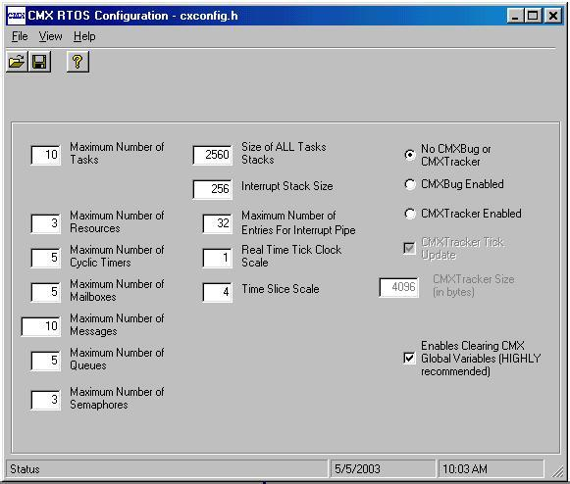
RTOS Configuration Manager
A Standard Windows GUI provides an intuitive and easy to use interface for configuring CMX RTOSes.

Slide 31
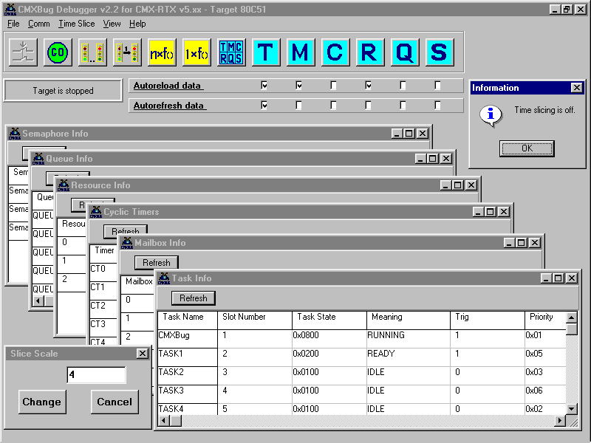
CMX-RTX...CMXBug
This module provides the user with the ability to view and modify different aspects of the CMX-RTX multi-tasking environment, while the user’s application code is running.

Slide 32
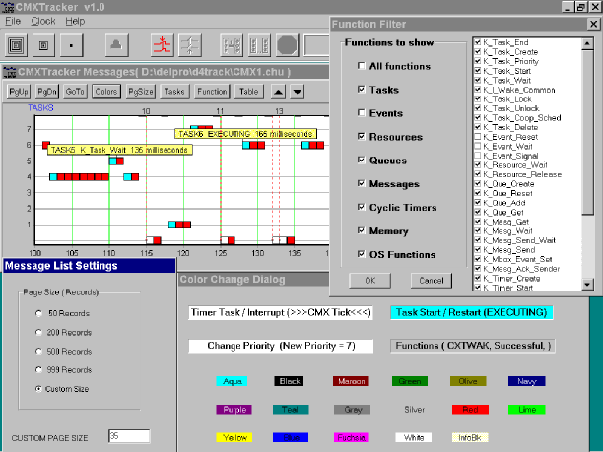
CMX-RTX...CMXTracker
This module pro-vides the user with the ability to log chronologically in real-time, the tasks’ execution flow, the CMX-RTX functions called (and parameters), CMX-RTX interrupts using functions, and the CMX-RTX system TICK.

Slide 33
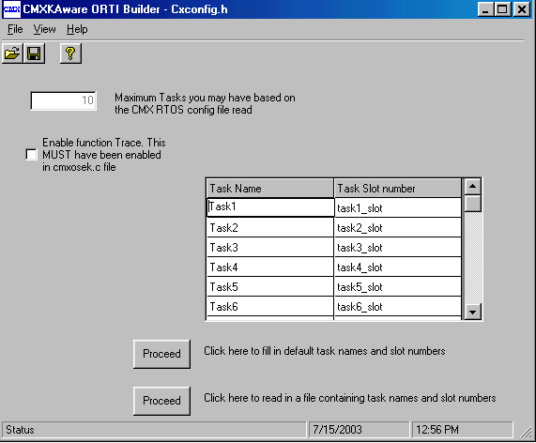
CMX-RTX....CMXKAware
CMXKAware provides the user with the ability to view their programming applications running under an RTOS via their In-Circuit Emulators and Simulators or ROM monitor debuggers.

Slide 34
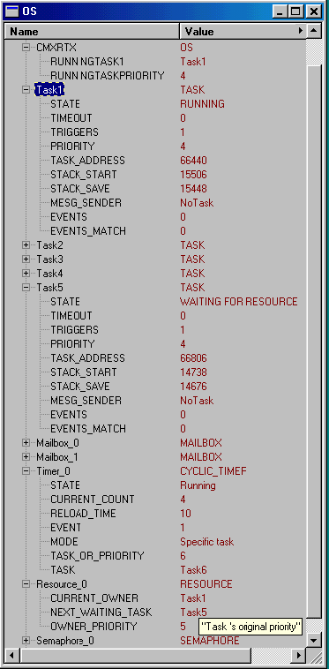
CMX-RTX....CMXKAware
CMXKAware allows a developer to view kernel objects (i.e., tasks, mailboxes, cyclic timers, etc.) as shown in this graphic.

Slide 35
CMX-Tiny+ ...an extremely “lean and mean” CMX-RTX!
For use in a “single-chip” solutions
Scaled down version of CMX-RTX, containing the most widely used functions and features, but designed for use with only the on-board ROM/RAM of the processor.
An extremely lean and mean kernel for those processors that have a minimum 512 bytes of RAM embedded on the processor’s silicon.

Slide 36
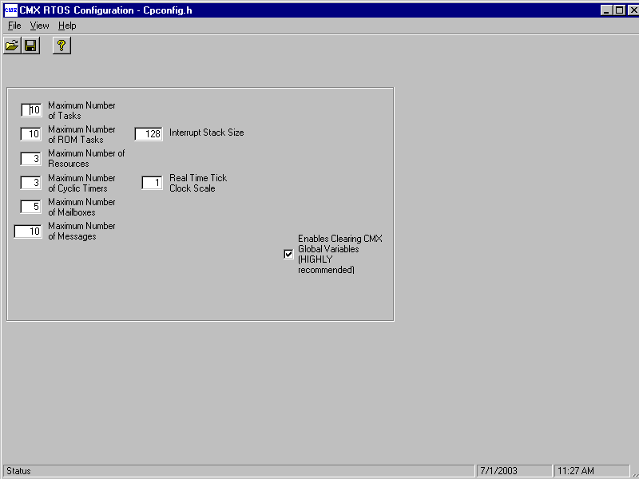
CMX-Tiny+ Configuration Manager

Slide 37
CMX TCP/IP
Portable TCP/IP Stack
High Performance
True, Multi-tasking Re-entrant Stack
Deterministic Memory Usage
Most Network Protocols & Applications
IETF RFC Compliant TCP/IP Support

Slide 38
CMX TCP/IP
Portable Drivers for Many Ethernet Controllers
UDP, TCP, IP, ICMP, IGMP, DNS, ARP, BOOTP, SLIP, Ethernet
RTOS Porting Layer
Standard BSD Socket Interface
High Performance Socket Interface
Operates with or without RTOS

Slide 39
CMX TCP/IP
Add On Options
DHCP
IMAP4
FTP
NAT
POP3
PPP
TFTP
PPPoE
SMTP
SNMP
Telnet Server
Wireless Ethernet
Web Client
Web Server

Slide 40
CMX-MicroNet
TCP/IP Networking with Limited ROM/RAM

Slide 41
CMX-MicroNet
Portable Drivers for Many Ethernet Controllers
UDP, TCP, IP, ICMP, IGMP, DNS, ARP, BOOTP, SLIP Protocol Support
RTOS Porting Layer
High Performance Socket Interface
Operates with or without RTOS

Slide 42
CMX-MicroNet
Add On Options
DNS
POP3
PPP
Ethernet
Wireless Ethernet
SNMP V1 & V2
HTTP Web Server
FTP Client/Server
SMTP
TFTP Client
DHCP Client

Slide 43
CMX-MicroNet
The Internet Protocol Stack
Application Interface
Application
I/O
TFTP
SMTP
POP3
FTP
HTTP
others
UDP
TCP
IP
PPP
SLIP
802.x/LAN
others
Physical Interface
Physical Media
Only a Selection of Protocols Might Be Needed for an Embedded Application

Slide 44
CMX-MicroNet
Runs With or Without an RTOS
Polled Mode
  Simpler to Implement
  Smaller Code Size
RTOS Mode
  Service Multiple Sockets Simultaneously
  Faster Response for Multiple Open Sockets
  No Blocking When Waiting for Packets on a Socket

Slide 45
CMX-MicroNet and Freescale
ColdFire - supports both CMX-MicroNet and CMX TCP/IP
HC12/HCS12 - supports CMX-MicroNet
68K or CPU32 - supports CMX TCP/IP
ARM - supports both CMX-MicroNet and CMX TCP/IP
Power PC - supports CMX TCP/IP

Slide 46
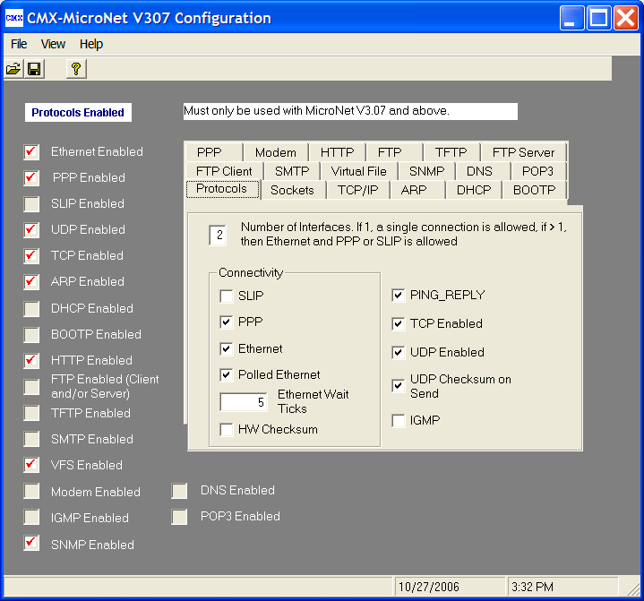
CMX-MicroNet Configuration Manager
A Standard Windows GUI provides an intuitive and easy to use interface for configuring CMX-MicroNet.

Slide 47
CMX-MicroNet
Summary
Tested and Proven with Hundreds of Design Wins Worldwide
No Proprietary Protocols.
Extremely Portable (Most 8-, 16-, 32-bit processors)
Runs Stand Alone or with RTOS
Free Source Code
No Royalties
Economical

Slide 48
CMX-MicroNet
Hundreds of Design Wins, Including:
ABB Automation
AMD
British Telecom Payphones
Emerson Appliance
Fisher Controls
GE Interlogix
Lucent
Mars Electronics
Matsushita Electric Works
Nordson Corp.
Philips
Plexus Technologies
Raytheon
Robert Bosch GmbH
Siemens V.D.O.
Simpson Electric
Varian Medical Systems
Vianet

Slide 49
CMX-MicroNet Articles in the Press
EE Times
Internetworking Treads on MCU Turf
http://www.eet.com/story/OEG20010521S0066
Circuit Cellar
A Detailed Look at the CMX-MicroNet
http://www.circuitcellar.com/library/print/1104/Eady172/index.htm

Slide 50
CMX-MicroNet or CMX TCP/IP?
CMX-MicroNet
8-Bit Processors
16-Bit or 32-bit Processors with Limited Memory
Optimized for Small Memory Requirements
CMX TCP/IP
16- and 32-Bit Processors
IETF RFC Compliant TCP/IP Support
Full-Featured
Most Protocols

Slide 51
CMX Systems...the Right Business Choice!
No Royalties on Deployed Products
Per User or Per Product Pricing
Free Source Code Provided
Free Technical Support and Updates

